Slide 1
VC Project Presentation
NN-based Video Coding & Compression
B04902002 許志軒
B04902068 吳孟軒

Slide 2
Outline
Problem Definition
Algorithm
Dataset
Experimental results
Discussions
Future Work

Slide 3
Problem Definition
Given a set of video
Use Deep Learning algorithms to obtain an encoding & decoding mechanism for video coding & compression base on that set of video
Instead of hand-crafted encoding/decoding mechanism

Slide 4
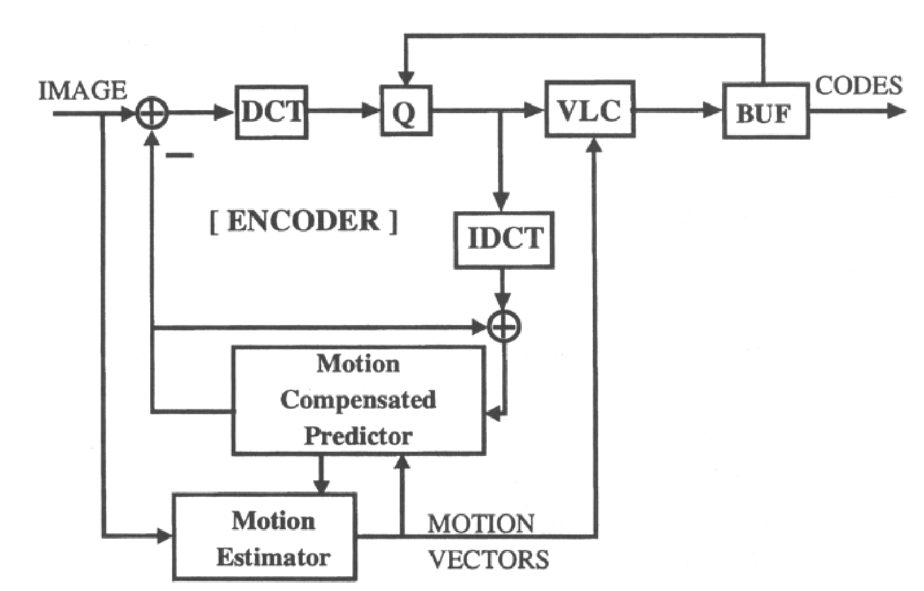
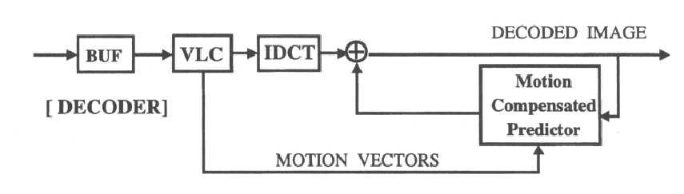
Problem Definition
Encode:
Decode:
⇒ 中間有許多人為設計出來的操作
Notes:
這是老師課堂上教授的傳統 video compression 的機制，中間可看到經過許多流程，比如DCT(Discrete Cosine Transform)、Quantization、VLC、Motion Estimation、Motion Comensation
人為設計出來的一定是最好的嗎? 可能有不錯的效果，但是可能只是local optimum

Slide 5


Problem Definition
不要經由人為的設計
讓機器自己學出怎麼做 Encode / Decode
Encode:
Decode:
Notes:
我們想用Machine Learning 的 technique，找出兩個黑盒子 Encoder、Decoder，幫我們進行coding、compression

Slide 6
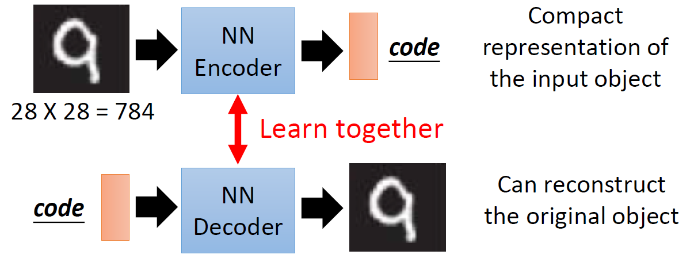
Algorithm : Autoencoder
(Source : http://speech.ee.ntu.edu.tw/~tlkagk/courses/ML_2017/Lecture/auto.pdf)
Notes:
survey到的方法 : auto-encoder： 用於圖片壓縮的deep learning方法，跟我們前面講的很像，圖片經過一個neural network轉變成code，達成encode；code再經由另一個neural network，reconstruct回圖片

Slide 7
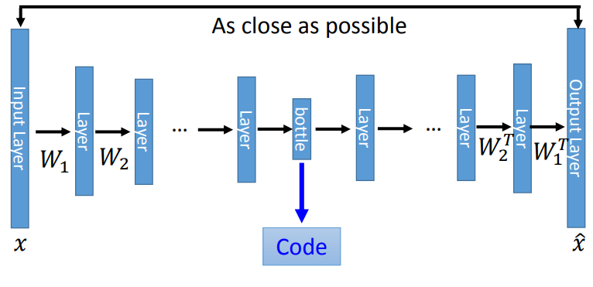
Algorithm : Autoencoder
(Source : http://speech.ee.ntu.edu.tw/~tlkagk/courses/ML_2017/Lecture/auto.pdf)
Notes:
train法：輸入圖片，經過一堆NN-layer，在bottleneck layer輸出成code，再把code經由另一堆NN-layer，重建回圖片，training目標是minimize reconstructed image 跟原先image之間的差
不過現在auto-encoder比較成熟是用於圖片，我們想要嘗試將auto-encoder作在影片上面，達成video compression

Slide 8
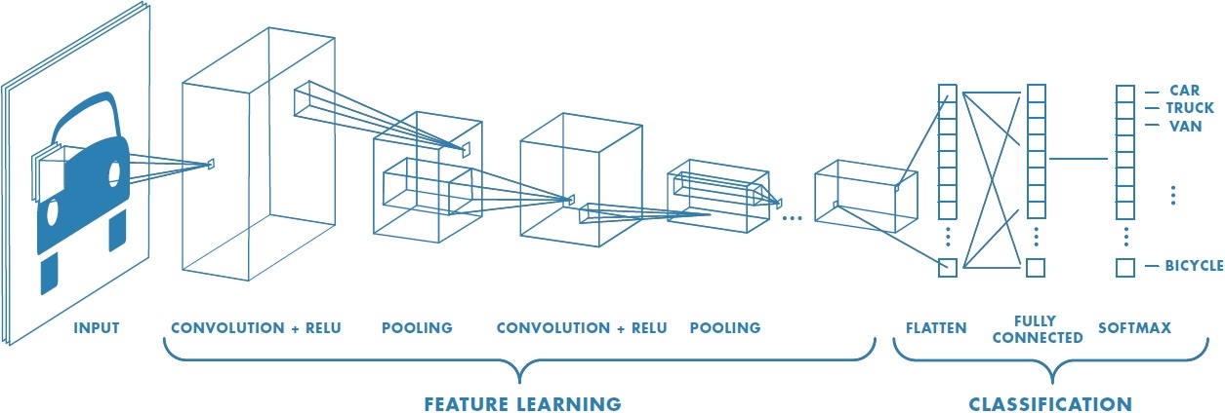
Algorithm : Convolution Neural Network (CNN)
(Source: https://www.mathworks.com/discovery/convolutional-neural-network.html)
Notes:
CNN: 常用於影像處理、feature extraction的 deep learning 技術

Slide 9
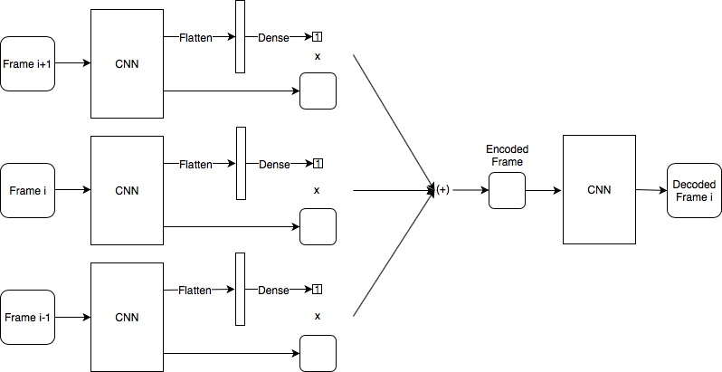
Algorithm - Our Model

Slide 10
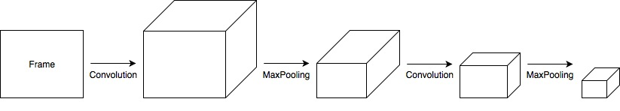
Algorithm - CNN

Slide 11
Dataset :
Format : YUV 4:2:0
Resolution : QCIF (176x144)
Video Trace Library - http://trace.eas.asu.edu/yuv/index.html
Xiph.org Video Test Media - https://media.xiph.org/video/derf/
Github Repo - https://github.com/linan142857/BRCN/tree/master/videos
Notes:
困難點：影片的data哪裡來？ youtube 2~3分鐘廢片？請教老師？

Slide 12
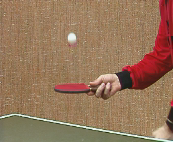
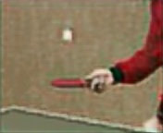

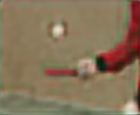
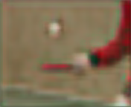
Experimental Results
Original
Cr = 4.8
Cr = 8
Cr = 12
Cr = 16

Slide 13
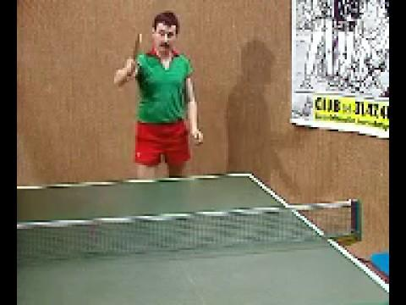
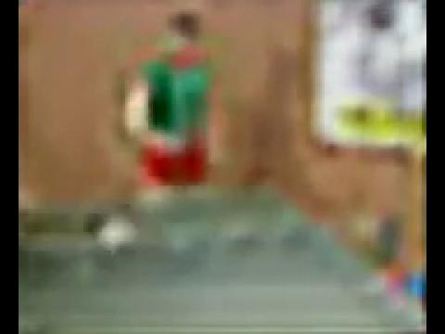
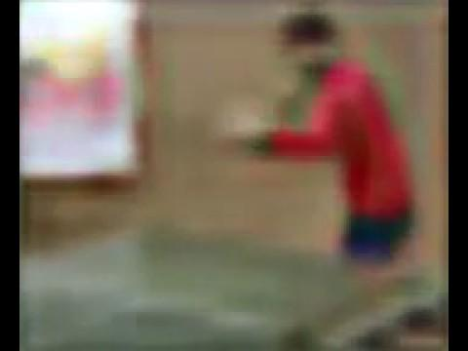
Experimental Results (with Videos)
Y: Cr = 2
U: Cr = 16
V: Cr = 16
Overall Cr = 4.8
PSNR = 29.72
Y: Cr = 4
U: Cr = 16
V: Cr = 16
Overall Cr = 8
PSNR = 29.95
Y: Cr = 8
U: Cr = 16
V: Cr = 16
Overall Cr = 12
PSNR = 29.52
Y: Cr = 16
U: Cr = 16
V: Cr = 16
Overall Cr = 16
PSNR = 28.68
Original

Slide 14
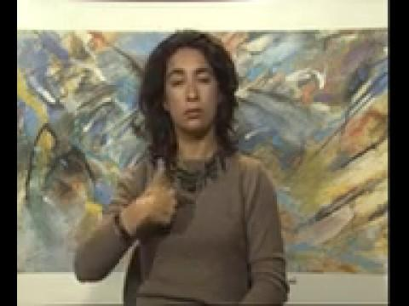
Experimental Results (with Videos)
Original
Video :
Compressed
Video :
(Overall Cr = 8)

Slide 15
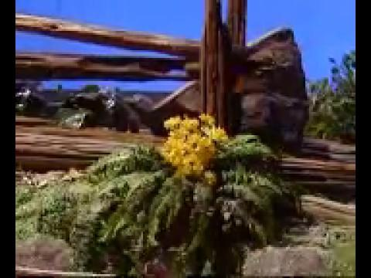
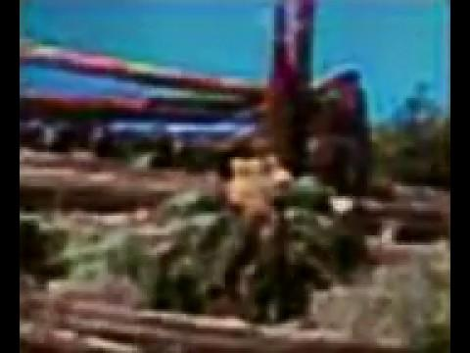
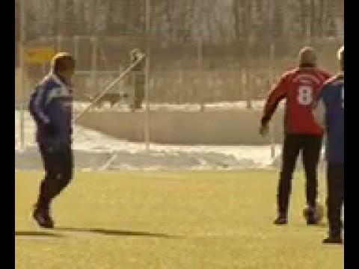
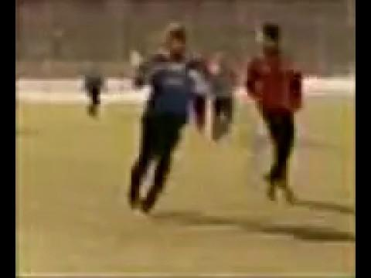
Experimental Results (with Videos)
Original
Video :
Compressed
Video :
(Overall Cr = 8)

Slide 16


Experimental Results (with Videos)
Original
Video :
Compressed
Video :
(Overall Cr = 8)

Slide 17
Discussions
優化 - Batch Normalization in CNN Layers
- Different CR in Y and UV components
未成功的嘗試 - Convlution 3D Layer
Notes:
困難點：影片的data哪裡來？ youtube 2~3分鐘廢片？請教老師？

Slide 18
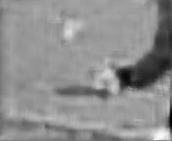
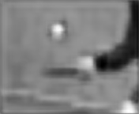
Discussions
優化 - Batch Normalization in CNN Layers
Cr = 16
有作 Batch Normalization
Cr = 16
沒作 Batch Normalization
Notes:
困難點：影片的data哪裡來？ youtube 2~3分鐘廢片？請教老師？

Slide 19
Discussions
優化 - Different CR in Y and UV components
Original
Overall Cr = 4.8
Y: Cr = 2
U: Cr = 16
V: Cr = 16
Overall Cr = 8
Y: Cr = 4
U: Cr = 16
V: Cr = 16
Overall Cr = 12
Y: Cr = 8
U: Cr = 16
V: Cr = 16
Overall Cr = 16
Y: Cr = 16
U: Cr = 16
V: Cr = 16
Notes:
困難點：影片的data哪裡來？ youtube 2~3分鐘廢片？請教老師？

Slide 20
Different CR in Y and UV components
Y: Cr = 2
U: Cr = 16
V: Cr = 16
Overall Cr = 4.8
PSNR = 29.72
Y: Cr = 4
U: Cr = 16
V: Cr = 16
Overall Cr = 8
PSNR = 29.95
Y: Cr = 8
U: Cr = 16
V: Cr = 16
Overall Cr = 12
PSNR = 29.52
Y: Cr = 16
U: Cr = 16
V: Cr = 16
Overall Cr = 16
PSNR = 28.68
Original

Slide 21
Different CR in Y and UV components
Y: Cr = 2
U: Cr = 2
V: Cr = 2
Overall Cr = 2
PSNR = 29.99
Y: Cr = 4
U: Cr = 4
V: Cr = 4
Overall Cr = 4
PSNR = 30.34
Y: Cr = 8
U: Cr = 8
V: Cr = 8
Overall Cr = 8
PSNR = 29.49
Y: Cr = 16
U: Cr = 16
V: Cr = 16
Overall Cr = 16
PSNR = 28.68

Slide 22
Reference
Our works & techniques are referenced from the below papers :
[1] Feng Jiang, Wen Tao, Shaohui Liu, Jie Ren, Xun Guo, Debin Zhao, “An End-to-End Compression Framework Based on Convolutional Neural Networks”, pp. 1-13, IEEE, 2017
[2] Armin Kappeler, Seunghwan Yoo ,Qiqin Dai, Aggelos K. Katsaggelos, “Super-resolution of Compressed Videos Using Convolutional Neural Networks”, pp. 1150-1154, IEEE, 2016
[3] Viorica Patraucean, Ankur Handa, Roberto Cipolla, “Spatio-temporal Video Autoencoder with Differentiable Memory”, pp.1-13, ICLR, 2015

Slide 23

End
Thanks for Listening

